Slide 1
PROJECT 5
IMDB Movie Analysis
Rikin Correya

Slide 2
Project Description
To analyse what factors influence highly or merely to the success of movies, where success is defined as HIGH IMDB Scores. This analysis is highly impactful for producers, directors and actors of film industry to make decisions for their future projects.
* All the Excel Files links are provided on Slide 7 after “Approach” Section. *
Note - Its a .xlsx file format, hence you may see certain things not shown properly if you open it on google sheets. So it’s recommended to download the file and open it in Excel.

Slide 3
Tech_Stack used
MS Excel
It was used in order to open the .csv file, cleaning the data and then applying statistical functions on the useful data to analyse, as well as a very important tool in order to draw insights out of the data in form of tables and charts.
Google Slides
It was used to prepare the report and to document all the insights of different tasks of the project.
PyCharm
It was used to scrape data from wikipedia sites of the movies using python packages, in order to collect the missing data and have an ordered data for further analysis.

Slide 4
Approach
Went through all the data, understood all the columns (28 columns and 5043 rows). This data contained NULL values, Blanks, Duplicates, Unwanted CHaracters and many Outliers as well. Followed the steps below mentioned to get a clean & ordered data for further analysis -
Removal of Duplicates - Selected the entire data,and deleted identical rows (Rows having all column values same as other row/s) (Total 45 duplicate rows were deleted).
Further removal of duplicates by Logic - 6 Columns were selected to find duplicates namely “Movie_Title”, “Title_Year”, “Director_Name”, “Actor1_Name”, “Movie_IMDB_Link” & “IMDB_Score”. (There is no way there can be 2 DIFFERENT MOVIES having all these 6 DIFFERENT FACTORS being the same) (Total 78 more duplicates were found and were removed).

Slide 5
3) NULL HANDLING - Deleted all rows where at least 10 or more columns were blank. ( 6 Removed )
4) Handling Outliers in Budget - Used the Z-Score method to detect outliers, and chose the top 15 outliers with highest budget (surpassing over 1 billion ). All of them were outliers as they were entered in Country Currency instead of dollars, so manually checked the internet for the budget in US Dollars for a generalised budget column and a more normalised distribution of Budget Column.
5) Handed Outliers in Duration - Using the Z-Score method and it was potential an error as they had values more than 500 min, hence replaced them with the Median of Duration Data.
6) Removed all the extra columns like likes, different actor names, etc which were not relevant for the tasks of project, resulting into a cleaner data.

Slide 6
7) Checked all the Columns required for tasks for any BLANKS or NULL Entries.
No Blanks were recognised in GENRE Column.
In DURATION, 14 blanks were detected, whose value was then manually searched and entered for correctness.
In LANGUAGE, 10 blanks were detected, and as all of them had USA as country of origin, “English” was set as the language.
IN DIRECTOR_NAME column. Total of 99 Blanks were detected.
As the number was too high to manually search & enter, using the IMDB_Links provided in the data, got the corresponding movies wikipedia page and using “BeautifulSoup” and “Pandas” packages of Python, we extracted names of directors along with the movie links into a new Excel file named “directors.xlsx”.
Out of 99 about 10 names were not found, which were manually then entered, and finally all the names were copied as a column and pasted in the Blank data of Director column.
Note -> Had to use wikipedia, as IMDB was not providing access to enter the URL through scraping.
Final data had 4914 Rows.

Slide 7
Links to Files
Solutions of the TASKS ( IMDB_Movies_SOLUTIONS.xlsx )
https://docs.google.com/spreadsheets/d/1sBUPWhYKxzA8mlgnFF39F5MhGK-WsGj6/edit?usp=sharing&ouid=109416836118642236108&rtpof=true&sd=true
Cleaned Final Data for Analysis ( Cleaned_IMDB_Data(AsPerTasks).xlsx )
https://docs.google.com/spreadsheets/d/1D4jZA6TqIhsJ5SAzxHZaj4hYaOxZIw7_/edit?usp=sharing&ouid=109416836118642236108&rtpof=true&sd=true
Scraped EXCEL File ( directors.xlsx)
https://docs.google.com/spreadsheets/d/1HOluR4vkBBD8vWr0u_nCgzdbCzbeHNXR/edit?usp=sharing&ouid=109416836118642236108&rtpof=true&sd=true
Python program for scraping ( scrapingdirectorname.py )
https://drive.google.com/file/d/1f1zk5F6JAUuCMYQIXgkT04Jx5KQ6IewW/view?usp=sharing

Slide 8
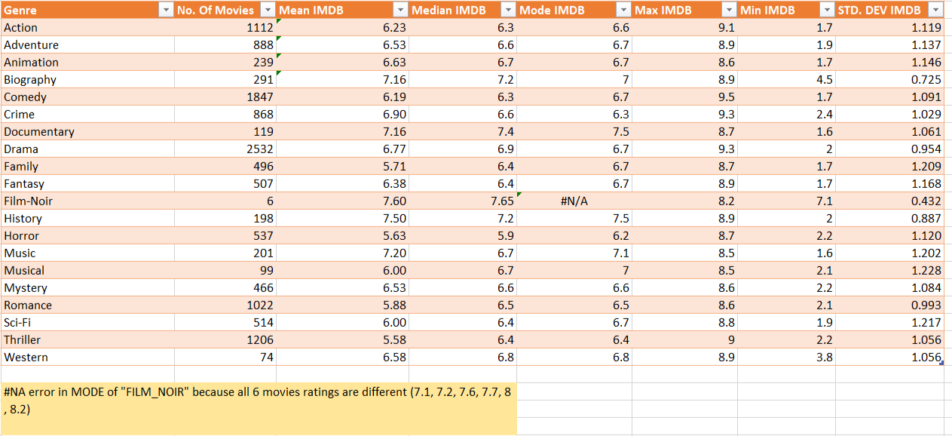
TASK A - Movie Genre Analysis
Task - Determine the most common genres of movies in the dataset. Then, for each genre, calculate descriptive statistics (mean, median, mode, range, variance, standard deviation) of the IMDB scores.

Slide 9
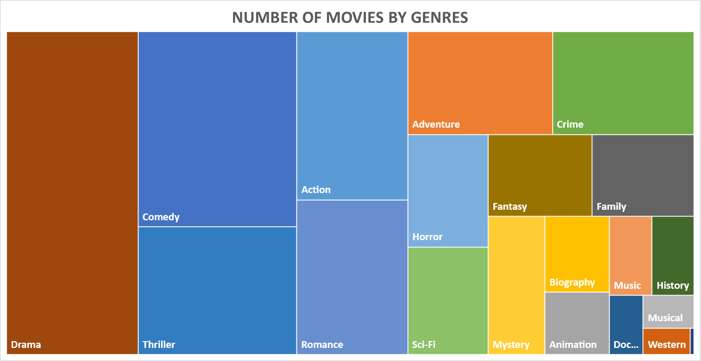
The most common Genre is as seen “Drama”, while “Comedy” and “Thriller” follows in 2nd and 3rd place.
The least common Genres are “Western”, “Musical”, “Music” , “Documentary” and “History”.

Slide 10
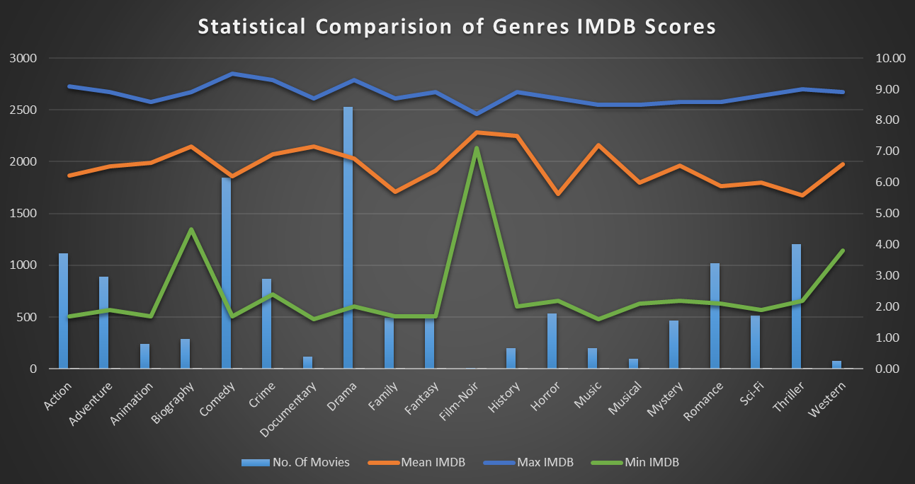
The max IMDB Score is achieved by “Comedy”.
While the least Min IMDB scores are achieved by genres like “Biography”, “Film-Noir”, “Western” which had very few movies, the Mean for these genres also remains relatively Higher than others.

Slide 11
TASK B - Movie Duration Analysis
Task - Analyze the distribution of movie durations and identify the relationship between movie duration and IMDB score.
Descriptive Stats | Values.
Mean | 107.0885586
Median | 103
Mode | 90
Standard Deviation | 24.55250957
Variance | 602.8397884

Slide 12
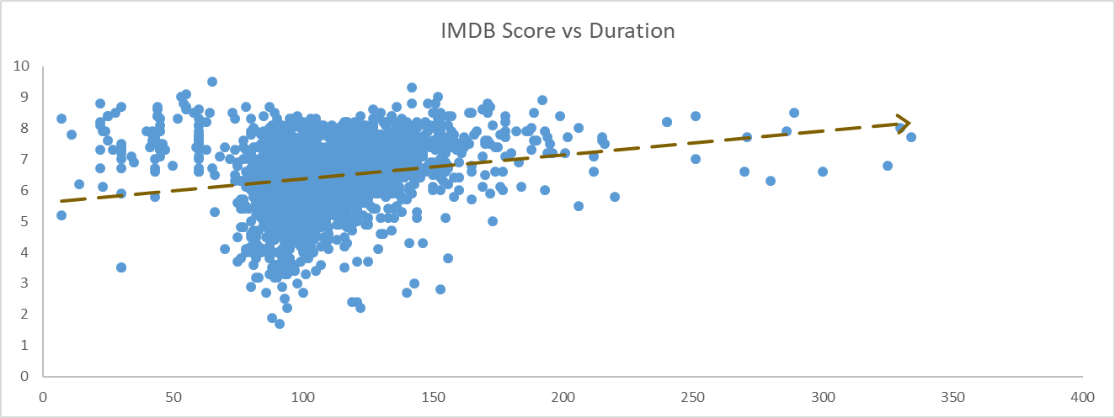
We can see a steady increase in the IMDB Score with increase in the Duration of movies.
Meanwhile IMDB Scores for movies with duration less than 60 mins tends to remain in the upper side of the trendline, showing a positive score.
The spread of IMDB Scores is the highest for movies having duration between 60 and 300 mins, considering Most movies are in this range hence the Widespread of Scores, but they are divided almost equally as a positive and negative scores as per the trendline.
The best duration range would be less than 100 mins, to get a risk free above average IMDB Score considering DURATION as a factor. (Could possibly be affected due to present scenario of less span of attention of people)

Slide 13
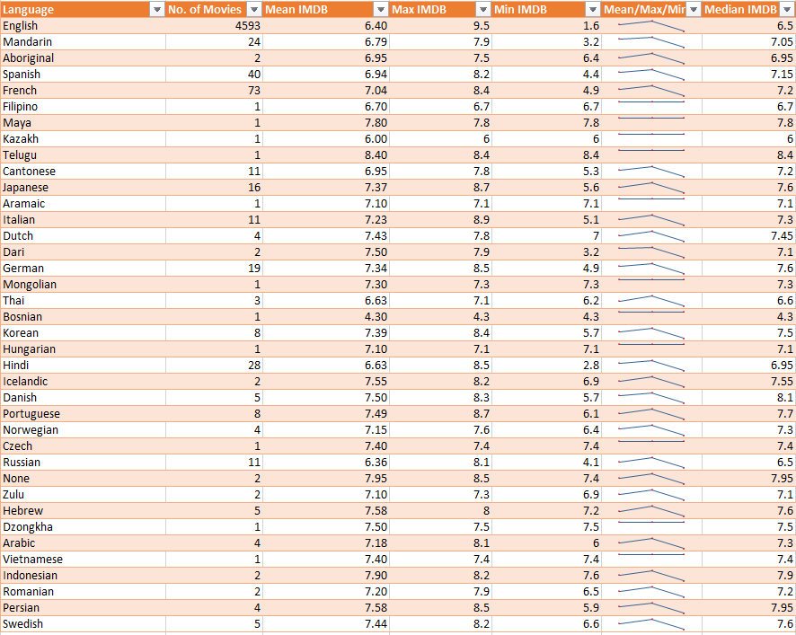
TASK C - Language Analysis
Task - Determine the most common languages used in movies and analyze their impact on the IMDB score using descriptive statistics.

Slide 14
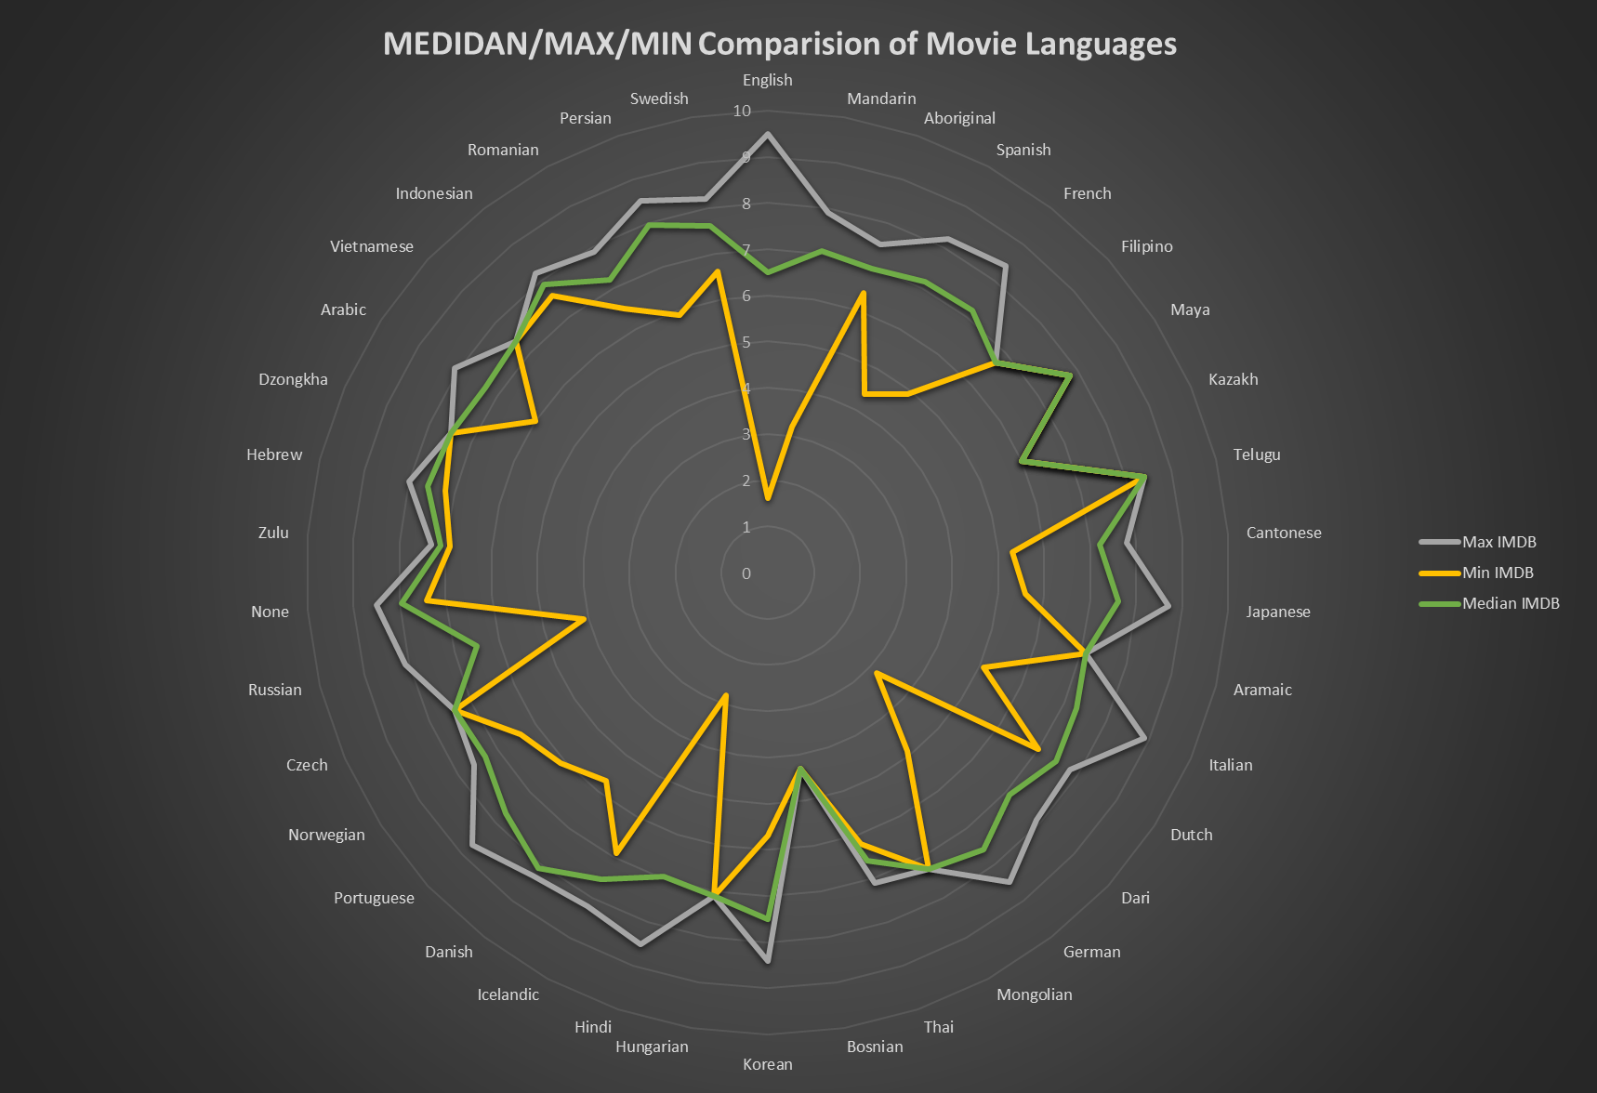
- English has the highest range of IMDB Score ranging from 2 uptill 9.5, because of the high number of movies having “English” as the language
- “Telugu” consisting of just 1 movie has Min,Max,Median all converging at one score, comparing with other Languages with just a Single movie, has the highest rating.
- “Danish” , “Persian” has the highest mean amongst Languages having more than 1 movies.

Slide 15
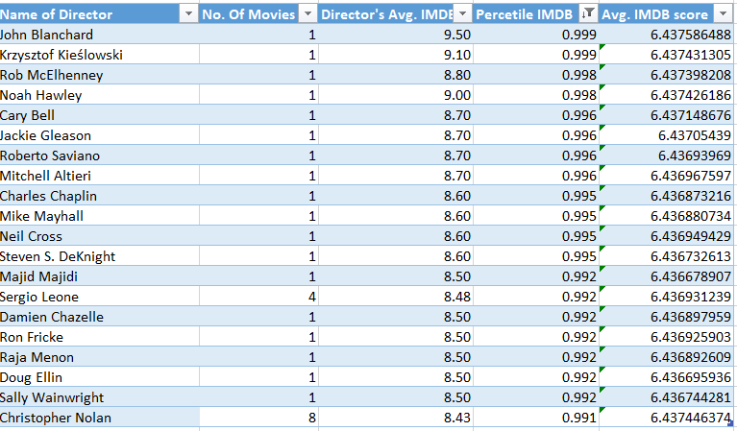
TASK D - Director Analysis
Task - Identify the top directors based on their average IMDB score and analyze their contribution to the success of movies using percentile calculations.
Note -> This img consists just top 20 Directors as per Percentiles, the rest of the table is available in the Solutions Excel file

Slide 16
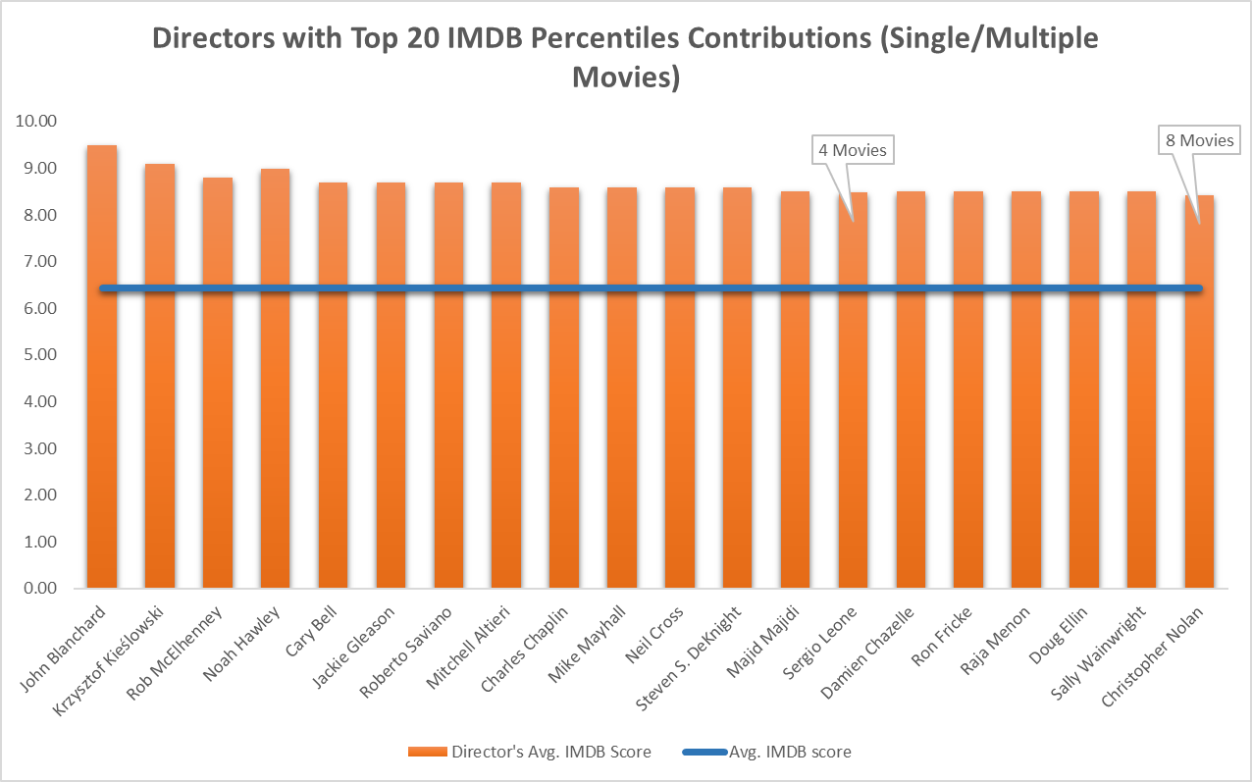
- The horizontal line passing through the middle represents Avg.IMDB Score of the entire movie data, hence we can observe how high are the ratings of these top 20 Directors relatively.
- Out of these 20, Sergio & Nolan can be concluded as the most talented directors as they have maintained an average rating of more than 8 IMDB, having directed 4 and 8 movies respectively.

Slide 17
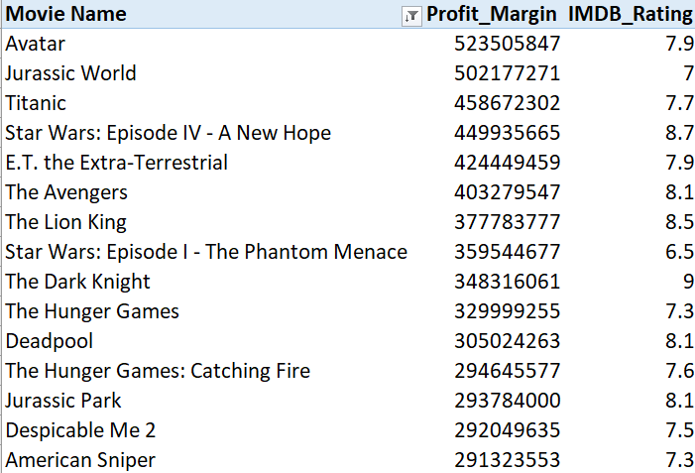
TASK E - Budget Analysis
Task - Analyze the correlation between movie budgets and gross earnings, and identify the movies with the highest profit margin.

Slide 18
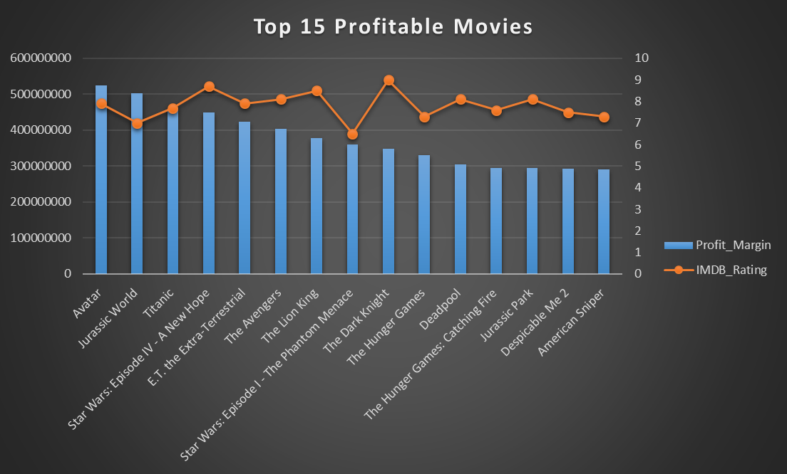
- There is no drastic high or low in the IMDB Score of the top 15 Most profitable Movies
- The highest rating amongst them is around 9 for “The Dark Knight” movie, even though its 9th Profitable, possibly high production costs resulted in lesser profit.
- Meanwhile, “Star Wars Ep 1” is ranked 8th even with a low score of 6, possibly because it was a new concept & people wanted to explore a new type, hence later an improvement of 8.5 score for “Star Wars Ep 4”, ranked 4th Profitable as well.

Slide 19
Result
I was able to understand Data Analytics more conceptually about how Directors and the IMDB scores were related, as well how can budget change the total Gross earning & IMDB scores of a particular movie, and so on.
Data Cleaning was the most crucial task that I gained more knowledge in this project, I learned how to scrape data using Python from websites, as per our needs. As well as, trying to handle NULL values and BLANK Values, after detecting Outliers and errors.
Data Cleaning turned out to be a long task but a very crucial task for most accurate Analysis of the data. Eg.( Movies having 500 as Duration would have changed the whole analysis of Task B, hence Identifying Outliers and removing them is very crucial)
Understood some more practical uses of Treemap and Radar Charts, along with the importance of Combo Charts in this project.

Slide 20
THANK
YOU

